Slide 1
Report to the EPS-EG Meeting: Lisbon, 13.-14.11.2014
My activity: Energy related data collection and processing
Source of data:
German data are openly available; good time resolution (15 min)
Data bank (load, wind, PV) by P.-F. Bach (see his report; http://pfbach.dk/)
(Germany, France, Belgium, UK, Ireland, Denmark, Spain) Czech Rep. F. Wertz
Spain: PV (E. Soria, C. Hidalgo)
French: H. Flocard, data with 30 min time resolution)
Japan: K. Muraoka
Sweden: E. Rachlew
Italy: G. Alimonte
Processing:
Germany: IPP-report (IPP_18_1.1.); Eur. Phys. J. Plus (2014) 129 20
Europe: Eur. Phys. J. Plus (2014) 129 219; proceedings Varenna SS (EPJ conf web)
Japan: paper in preparation
Other publications: D. Grant et al., Rev.´Energie 619 211 (2014).

Slide 2
Proceedure
1. Scaling to 100%
Assumptions:
no savings in electricity consumption
hydro remains the same, subtracted from load
no nuclear power
no biogas
no cross-country exchange
no losses

Slide 3
2. Mix between wind and PV, onshore and offshore wind

Slide 4
3. Analysis
what has to be installed:
remaining need for back-up:
extent of surplus energy:
storage:
dynamics of back-up system:
conditions for DSM (demand-side management):
CO2 reduction:
savings and use of biogas for a 100% supply by RES:
what is a reasonable share by RES:

Slide 5
3. Analysis (Germany)
what has to be installed: enough to supply Europe
remaining need for back-up: 78%
extent of surplus energy: consumption of Poland
storage: formally, 33 TWh
dynamics of back-up system: from 0 to the load, strongly increased gradients
conditions for DSM (demand-side management): price is low during day
CO2 reduction:
savings and use of biogas for a 100% supply by RES: e.g. 40 TWh, 30% consumption
what is a reasonable share by RES: 40%

Slide 6
3. Analysis (Germany)
what has to be installed: enough to supply Europe
remaining need for back-up: 78%
extent of surplus energy: consumption of Poland
storage: formally, 33 TWh
dynamics of back-up system: from 0 to the load, strongly increased gradients
conditions for DSM (demand-side management): price is low during day
CO2 reduction:
savings and use of biogas for a 100% supply by RES: e.g. 40 TWh, 30% consumption
what is a reasonable share by RES: 40%

Slide 7
3. Analysis (Germany)
what has to be installed: enough to supply Europe
remaining need for back-up: 78%
extent of surplus energy: consumption of Poland
storage: formally, 33 TWh
dynamics of back-up system: from 0 to the load, strongly increased gradients
conditions for DSM (demand-side management): price is low during day
CO2 reduction:
savings and use of biogas for a 100% supply by RES: e.g. 40 TWh, 30% consumption
what is a reasonable share by RES: 40%
Use weekends!

Slide 8
3. Analysis (EU)
expectation: the EU-RE-field is averaged
Averaging only by wind

Slide 9
The benefit:
The back-up energy is reduced by 24%,
the maximal back-up power by 9%,
the maximal surplus power by 15%,
the maximal grid power by 7%,
the typical grid fluctuation level by 35%
the maximal storage capacity by 28%

Slide 10
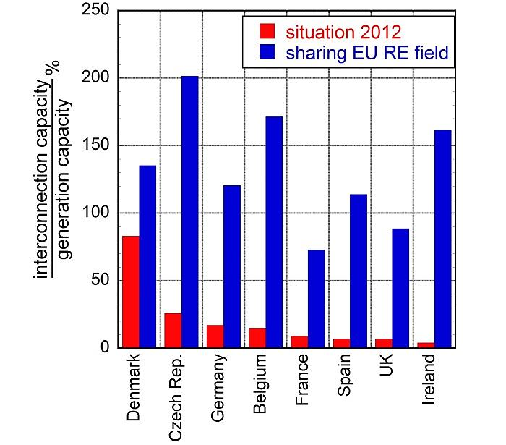
The benefit:
The back-up energy is reduced by 24%,
the maximal back-up power by 9%,
the maximal surplus power by 15%,
the maximal grid power by 7%,
the typical grid fluctuation level by 35%
the maximal storage capacity by 28%
Interconnection:

Slide 11
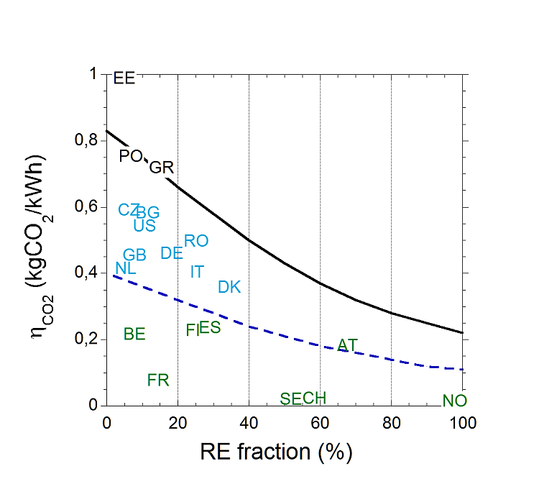
The CO2-situation
Countries with hydro + nuclear are already where others would like to be in 2050

Slide 12
The development costs
Source: F. Wagner
Finadvice

